Slide 1

FINAL PROJECT gate. shop
Junior Software Tester
Madalina Blaga
Course Software/Manual Testing (QA)
Software Testing, gr. 33

Slide 2
WEBSITE DESCRIPTION
GATE.SHOP is an e-commerce web site, offering for sale clothes, shoes and accessories for men women and kids and diverse home décor items.
It targets customers from eastern European countries.
The scope of the website is to sell products to eastern European clients, while ensuring:
a satisfying shopping experience for the clients
easy to access and to use web site
good customer service
secure data and payments

Slide 3
TEST STRATEGY
Smoke testing - to decide the website that I will choose
Exploratory testing - to identify website features
Mind map the features and identify the key ones
Inspect Html code - to identify requirements on text fields ( range values) , mandatory error messages.
Design test plan
Identify the necessary testing tools and environments
Design test cases - to check with priority the key functional and non-functional requirements
Run the established test cases and record the result
Report all identified bugs.
Elaborate final test report.
Notes:
Market share held by internet browsers in Europe 2009-2021 – on STATISTA.com
2021 • Chrome 60.1%
• Safari 19.85%
• Firefox 6.3%
• Edge 4.81%

Slide 4











TEST TOOLS
Windows 10, Os build 21H2/ 19044.1645,
WEB.DEV for Web accessibility testing
SUCURI Site check for security audit
BROWSERSTACK – WEB Tool for responsive Design Testing on Real Devices
Mantis Bug Tracker
Microsoft Excel for test cases design and monitoring
Browser Microsoft Edge (Version 107.0.1418.26 (Official build) (64-bit))
Browser Chrome (Version 107.0.5304.88 (Official Build) (64-bit))
DELL Laptop Intel(R) Core(TM) i5-10310U CPU @ 1.70GHz 2.21 GHz ; 64-bit operating system; 8 GB RAM
Xmind and Visio – for mind map
Notes:
Market share held by internet browsers in Europe 2009-2021 – on STATISTA.com
2021 • Chrome 60.1%
• Safari 19.85%
• Firefox 6.3%
• Edge 4.81%

Slide 5

TEST TYPES
Functional testing
Smoke testing
Exploratory testing to check main functionalities
Usability testing
Pozitive testing
Negative testing
Cross-compatibility with Browser , Operating Systems and Mobile Devices
Accessibility testing
Connectivity testing
Responsive testing
User interface testing
Dynamic testing
Non-functional testing
Web security testing
Static testing

Slide 6
TEST CASE OVERVIEW
ID. No. | Test overview | No. of tests
1 | Create new account | 48
2 | Login | 8
3 | Forgot password | 3
4 | Add to cart | 3
5 | Continue shopping | 1
6 | Update cart | 5
7 | Favorite list | 3
8 | Remove from cart | 3
9 | Checkout | 2
10 | Search | 7
11 | Logout | 2
12 | My account | 12
13 | Payment and delivery | 7
14 | Sort and filter | 6
15 | Responsive testing | 6
16 | Web accessibility testing | 4
17 | Connectivity | 4
18 | Security testing | 9
Notes:
Market share held by internet browsers in Europe 2009-2021 – on STATISTA.com
2021 • Chrome 60.1%
• Safari 19.85%
• Firefox 6.3%
• Edge 4.81%

Slide 7
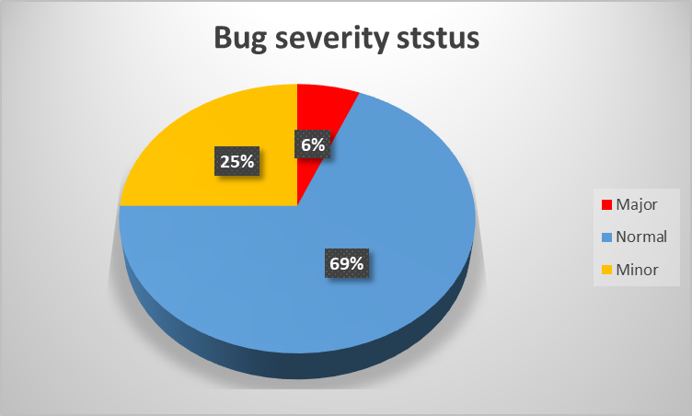
BUGS OVERVIEW
Defect ID | Defect summary | Severity
0045166 | No firewall detected during security scan of the website | major
0045139 | Price filter resets to default if the value is typed in the price box | minor
0045138 | New card cannot be added without placing an order | normal
0045137 | No option to delete all items from the bag at once only remove on by one | minor
0045136 | Form Cart only move product to favourite list is available | minor
0045135 | More than quantity than on stock for a product can be added in the cart. | normal
0045134 | Missing feature to type in the quantity for any product | minor
0045133 | When login with incorrect e-mail address the correct error message is not displayed | normal
0044998 | Registration form - Cod postal field - not showing the correct error message when 11 characters are typed in | normal
0044999 | In registration form the text field "Localitate" is a mandatory field but is not labelled with " * " | normal
0044997 | In registration form the text field "Cod postal" is a mandatory field but is not labelled with "*" | normal
0044996 | Registration form - "Strada" field - accepts symbols as valid input - no error message is displayed | normal
0044972 | Street number field of the registration form accepts decimal numbers | normal
0044971 | Street number field of the registration form accepts alphabetical characters | normal
0044970 | Street text field of the registration form accepts decimal numbers | normal
0044961 | Street text field of the registration form accepts integer numbers | normal
Notes:
Market share held by internet browsers in Europe 2009-2021 – on STATISTA.com
2021 • Chrome 60.1%
• Safari 19.85%
• Firefox 6.3%
• Edge 4.81%

Slide 8
TEST CASE RESULTS
From a total of 133 tests:
86% - passed status;
12% - failed status
2% - improvements identified that may increase end user experience while using the web site

Slide 9
CONCLUSIONS
All key functionalities tested are performing as per client requirements.
The main issue is the missing of a firewall – that can increase the security risk so a firewall to increase web site security is necessary ( as security is both a legal and client requirement).
The website has some minor issues that can have an impact for the final user: mainly in the shopping cart functionality, in order to avoid repetitive actions that are time consuming.

Slide 10

LESSONS LEARNT
The past four months represented a big learning curve for me, discovering:
what is actually software testing,
what are the reasons behind performing testing,
methods and tools ( Mantis, Visual Studio, Postman, XMind) I learned that “The sky is the limit” when we talk about testing types.
I learned that I really love testing but that it is far from being easy
And last but not least I got to know some great colleagues and mentors.
The final project was the opportunity to validate all that I have learned in terms of testing process and applying them that knowledge.
Thank you!

